Slide 1
Student Performance Monitoring System (SPMS)
Project done by :
Shoeb Uddin Ahmed 1920038
Istiak Ahammad Limon 1930038
Tahsin Bin Khaled 1830422

Slide 2
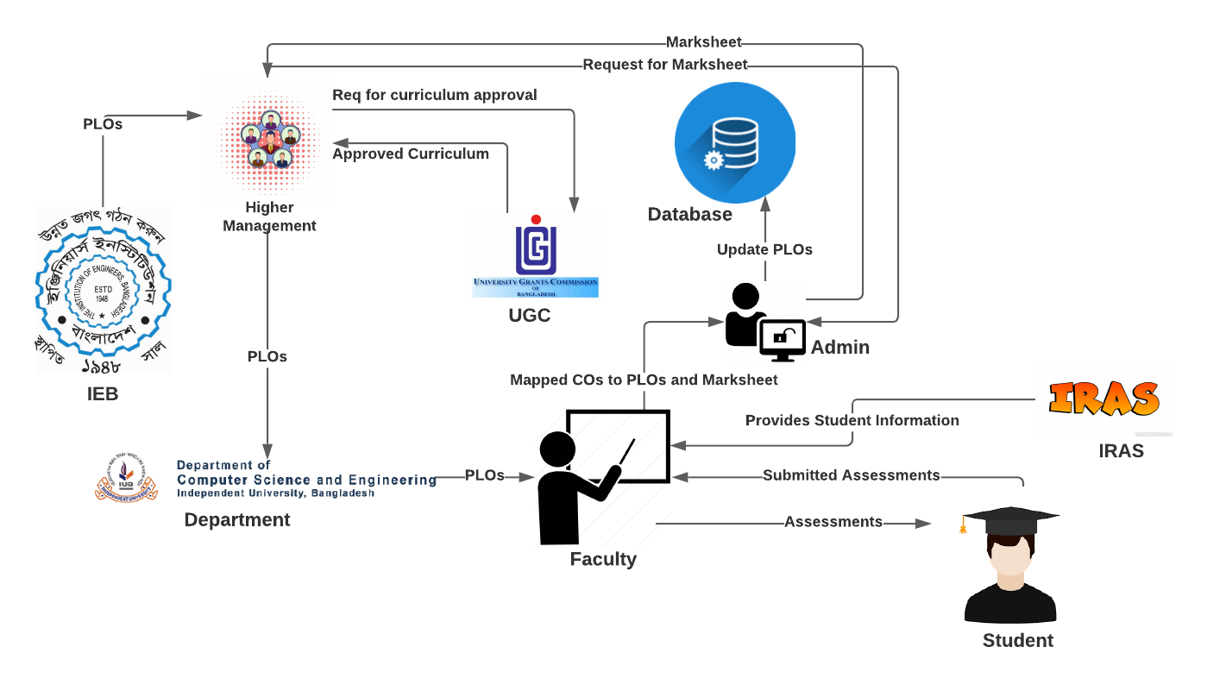
Rich Picture (Existing system)

Slide 3
Problem Analysis
The Faculty members have to provide the mark sheet to Admin and then the Admin enters the mark sheet into the Database. This process becomes too time-consuming and uses up a lot of extra resources.
Since the faculty has to send the mark sheet all the way to the admin before getting uploaded to the database, and it takes up much of the time using unnecessary resources,
Our software allows the faculty to directly update the marks to the database. Hence, the use or participation of the admin is negligible.

Slide 4
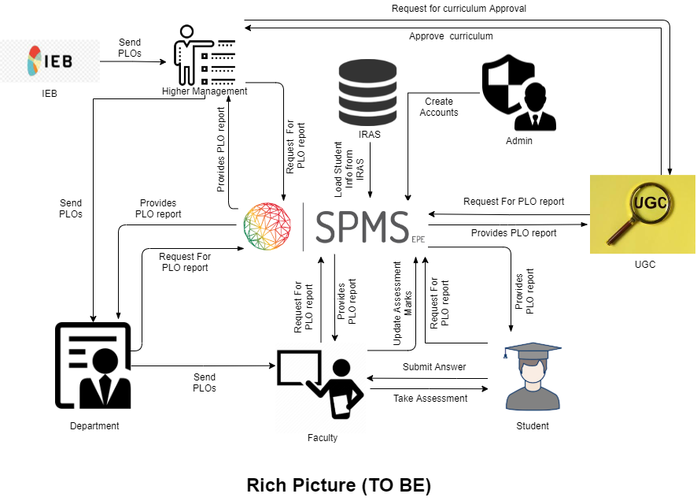
Rich Picture (Proposed system)

Slide 5
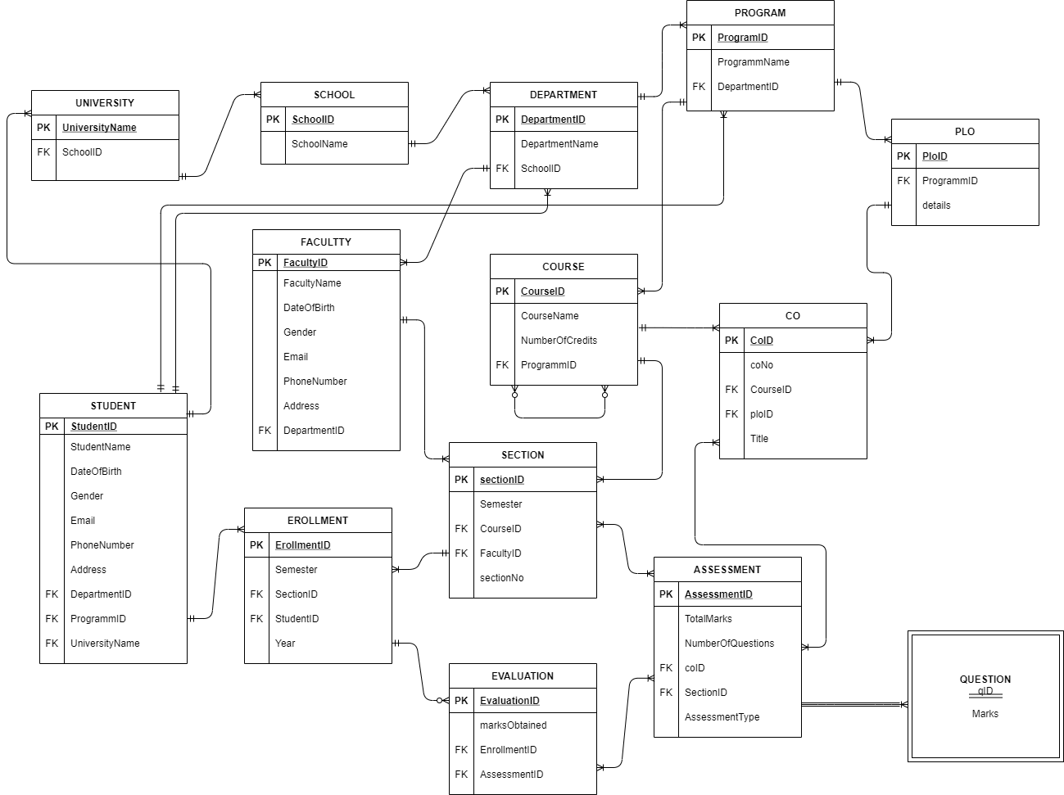
Entity Relationship Diagram (ERD)

Slide 6
universityName➔ | schoolID
SchoolID➔ | SchoolName
DepartmentID➔ | DepartmentName, SchoolID
ProgramID➔ | programName, DepartmentID
FacultyID➔ | facultyName, gender, dateOfBirth, email, phone, address, DepartmentID
StudentID➔ | studentName, dateOfBirth, gender, email, phone, address,DepartmentID,ProgramID,universityName
CourseID➔ | courseName, noOfCredits, courseType, ProgramID
ploID➔ | ploNo, details, ProgramID
coID➔ | coNo, ploID, CourseID, title
SectionID➔ | sectionNo, semester, CourseID, FacultyID
EnrollmentID➔ | semester, year, SectionID, StudentID
assessmentNo➔ | ocID, SectionID,assessmentType, NumberOfQuestions
EvaluationID➔ | evaluationNo, obtainedMarks, assesmentNo, EnrollmentID
DEPENDENCY TABLE

Slide 7
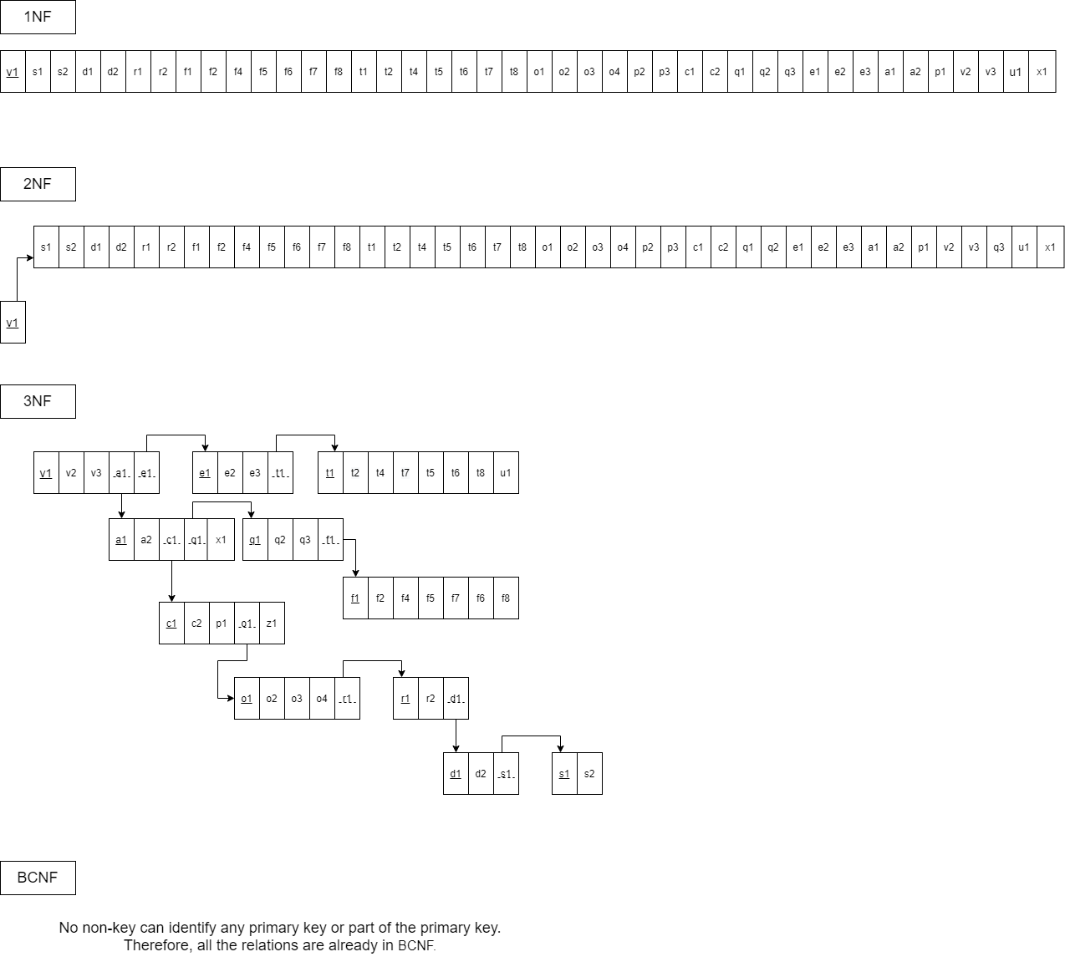
NORMALIZATION

Slide 8
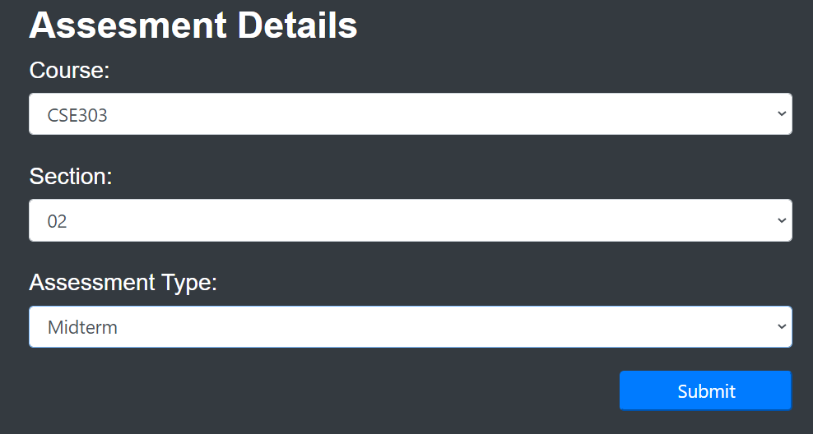
INPUT FORMS
Assessment Details

Slide 9
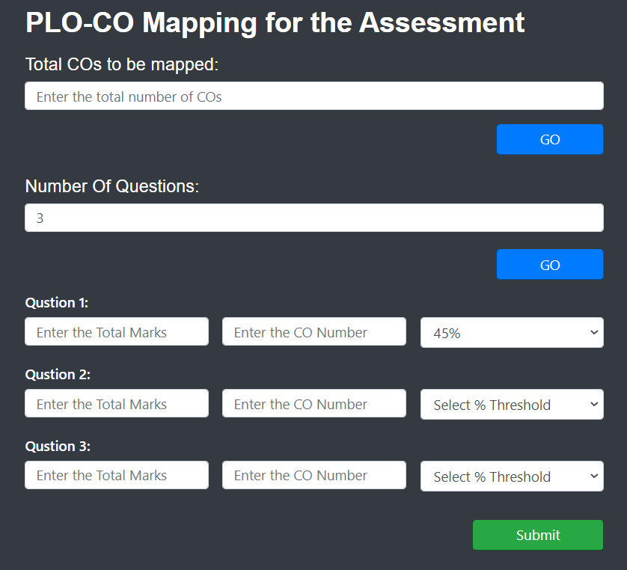
PLO-CO mapping for the assessment

Slide 10
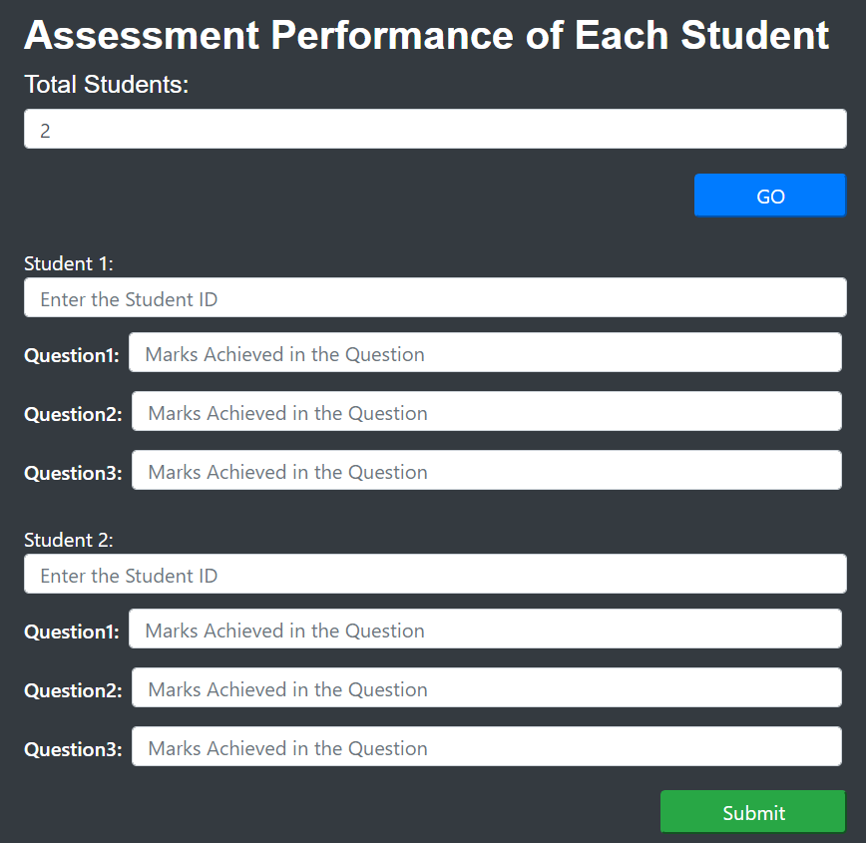
Assessment performance of each student

Slide 11
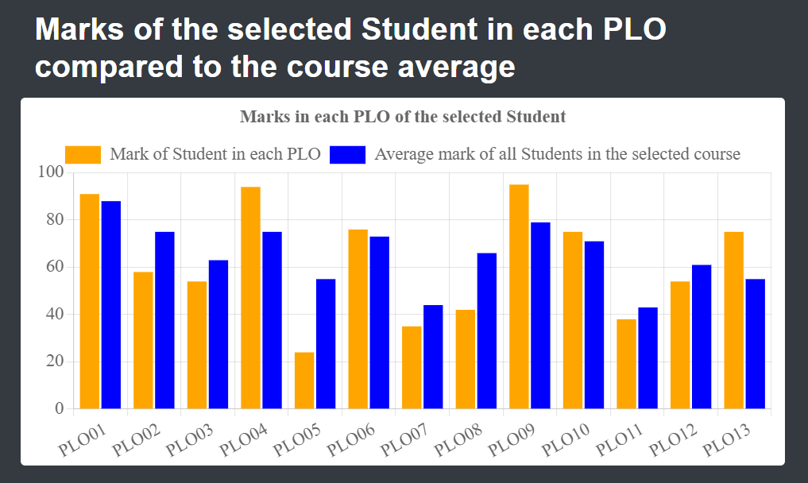
OUTPUT VIEWS
Student Wise PLO ANALYSIS:

Slide 12
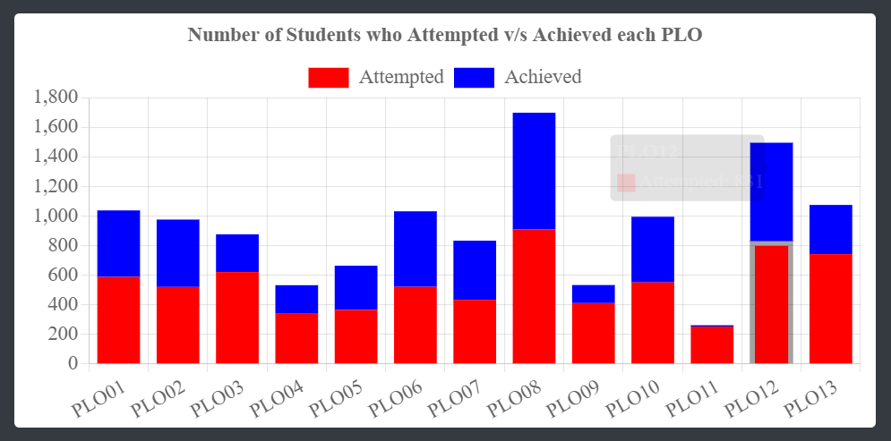
PLO attempted VS Achieved By Students:

Slide 13
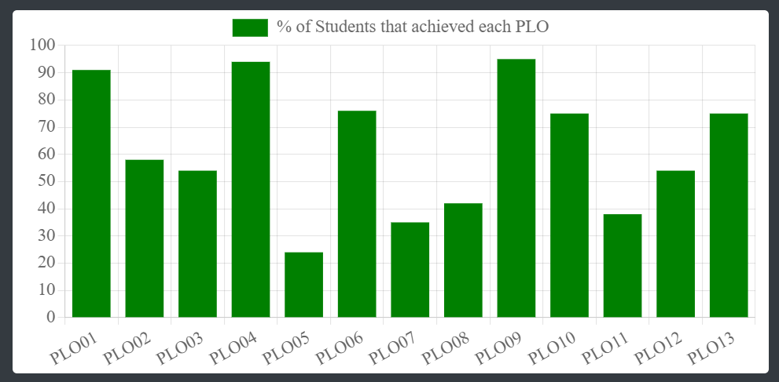
COURSE WISE PLO ANALYSIS:

Slide 14
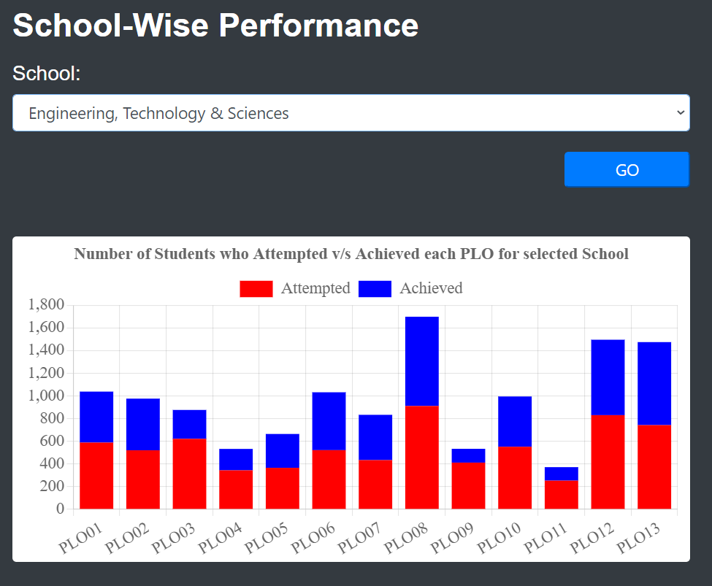
School-wise number of students attempted vs achieved for each PLO:

Slide 15
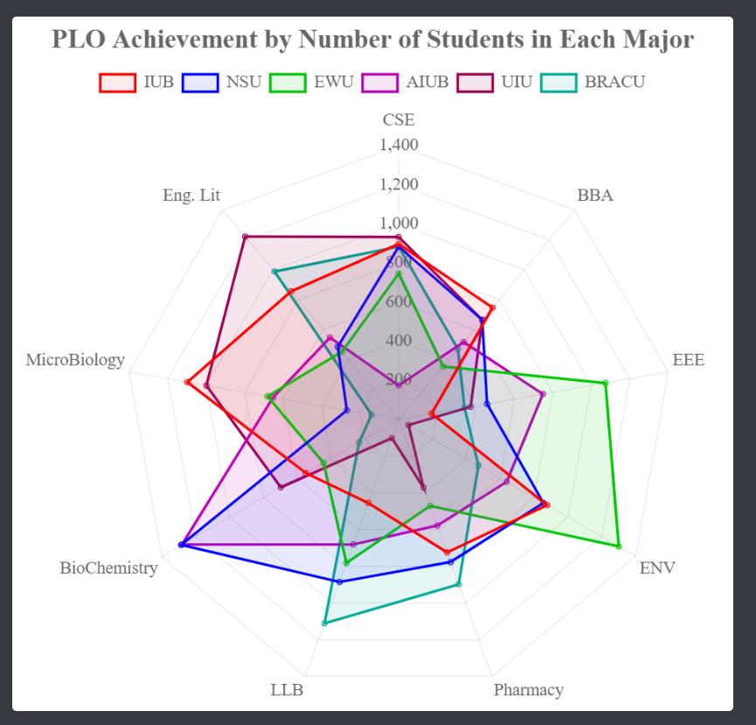
University Wise PLO ANALYSIS:

Slide 16


